Slide 1
CSC510 Group 4 - Recipe Extractor and Storage Web Application Prototype
Sharvil, Jake, Anil, Mitchell, Geoff, Nazia

Slide 2
Prototype Assumptions
Release is a prototype
Not intended for full release
(recipe printing, image previews, etc.)
Goal is to be a “proof-of-concept” to demonstrate feasibility of base architecture and technology for future development

Slide 3
Prototype Technology
Web Application
Ampps stack
Backend: MySQL
Frontend: React
API: PHP, Javascript
Web Scraper: Python
Configuration Control via GitHub Repository

Slide 4
Quality Attribute Scenarios/Architectural Requirements
Interoperability with Recipe Websites - Sharvil
Availability for Faulty Websites - Jake
Usability of Recipe List - Anil
Usability of Custom Recipe Interface - Mitchell
Modifiability of Recipe Database - Geoff
Reliability of User Search - Nazia

Slide 5
Architectural Diagram
Legend
Top Level Components
Servers
GET/POST Requests
Web Browser
React Front End
-Handle User Input
-Display Results
-Search Functionality
-Intermediary between extraction and database
Flask Local Server
Ampps Local Server
Backend Python
-Recipe Extraction Functionality
SQL Backend Database
-Recipe Storage
-Support search request

Slide 6
Interoperability with Recipe Websites - Sharvil
Interoperability With Recipe Websites | Stimulus Source | Recipe Websites
 | Stimulus | HTML page with recipe information
 | Artifact | Recipe Conversion System
 | Environment | Runtime
 | Response | Extract all necessary recipe information from website and convert to electronic recipe card
 | Response Measure | With 95% of information being successfully communicated

Slide 7
Availability for Faulty Websites - Jake
Availability for Faulty Websites | Stimulus Source | End User
 | Stimulus | Unanticipated URL
 | Artifact | System
 | Environment | Running
 | Response | Pop up to show that the website is currently not available, and show an option to view the entire website instead.
 | Response Measure | Provides pop ups for non parsable websites 98% of the time.

Slide 8
Usability of Recipe List - Anil
Usability of Recipe List | Stimulus Source | End user
 | Stimulus | User wish for interface to feel easy to understand and use
 | Artifact | System
 | Environment | Runtime
 | Response | display all the available(stored) recipes in sensible format
 | Response Measure | Average usability rating of at least 8/10 by users.

Slide 9
Usability of Custom Recipe Interface - Mitchell
Usability of Custom Recipe Interface | Stimulus Source | End User
 | Stimulus | User wish for interface to feel easy and comfortable
 | Artifact | System
 | Environment | Runtime
 | Response | System displays helpful text and well-labelled UI fields to make entering a recipe easy.
 | Response Measure | Average usability rating of at least 8/10 by users.

Slide 10
Modifiability of Database - Geoff
Modifiability of Database | Stimulus Source | End User
 | Stimulus | Form with modified recipe data
 | Artifact | System
 | Environment | Runtime (under normal conditions)
 | Response | Send API to modify the data within the database.
 | Response Measure | All non-modified and categorical data related to the recipe and other recipes is preserved.

Slide 11
Reliability of User Search - Nazia
Reliability of User Search | Stimulus Source | End User
 | Stimulus | Search keyword (title or ingredient)
 | Artifact | System
 | Environment | Runtime (normal conditions)
 | Response | Display relevant recipes from saved recipe database.
 | Response Measure | 98% of the recipes displayed are relevant to user search terms

Slide 12
Most Valuable Class Portions
Project Monitoring and Control
Version control
Monitor Stakeholder Involvement
Integration
Establishing Integration Plan
Manage Interfaces
Project Planning
Estimation

Slide 13
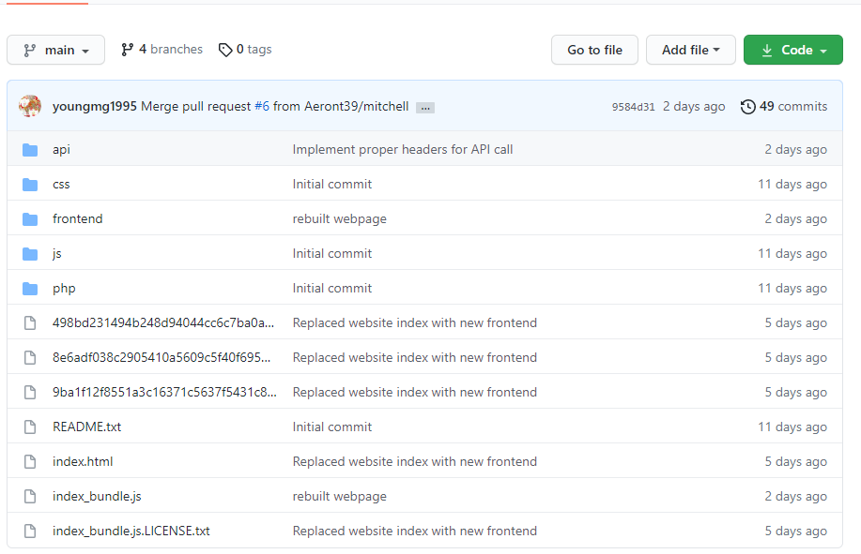
Project Monitoring and Control

Slide 14
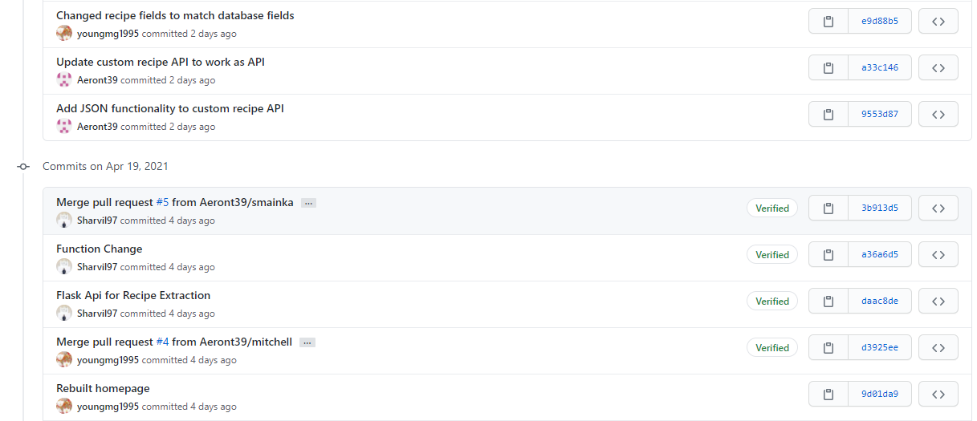
Project Monitoring and Control

Slide 15
Integration
SG 1 Prepare for Product Integration
SP 1.1 Establish an Integration Strategy
SP 1.2 Establish the Product Integration Environment
SP 1.3 Establish Product Integration Procedures and Criteria
SG 2 Ensure Interface Compatibility
SP 2.1 Review Interface Descriptions for Completeness
SP 2.2 Manage Interfaces
SG 3 Assemble Product Components and Deliver the Product
SP 3.1 Confirm Readiness of Product Components for Integration
SP 3.2 Assemble Product Components
SP 3.3 Evaluate Assembled Product Components
SP 3.4 Package and Deliver the Product or Product Component

Slide 16
Integration
Front End
React (Javascript)
Mitchell
Anil, Nazia, Sharvil, Jake
API/Extraction Module
(Search, Display List, Read from Web Pages)
PHP, Python
Geoff
SQL
Ampps, MySQL

Slide 17
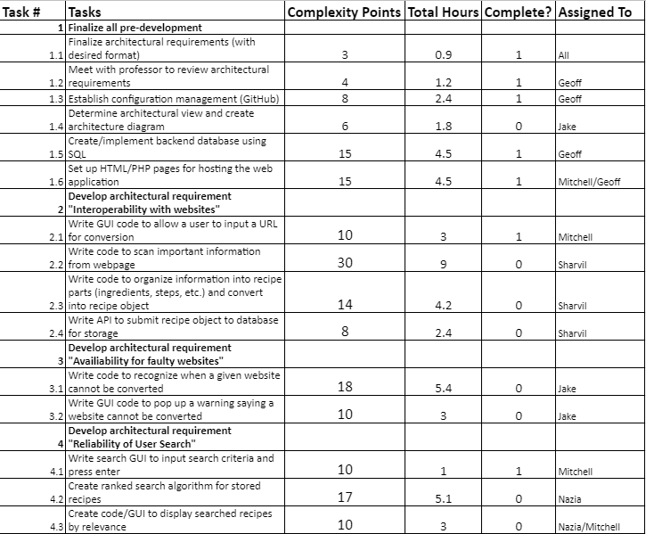
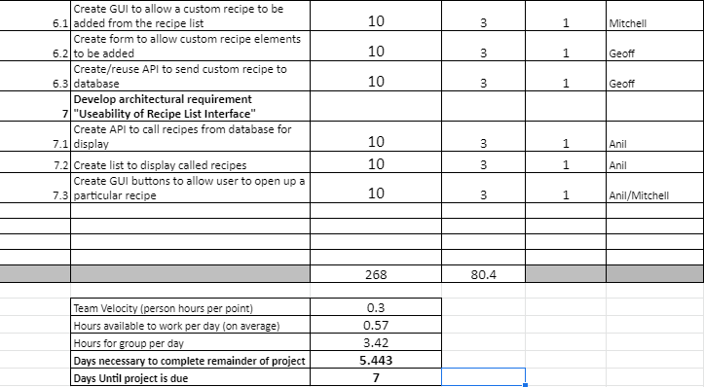
Estimation - Simplified Planning Poker

Slide 18
CSC510 Group 4 - Recipe Extractor and Storage Web Application
Sharvil, Jake, Anil, Mitchell, Geoff, Nazia

